Slide 1
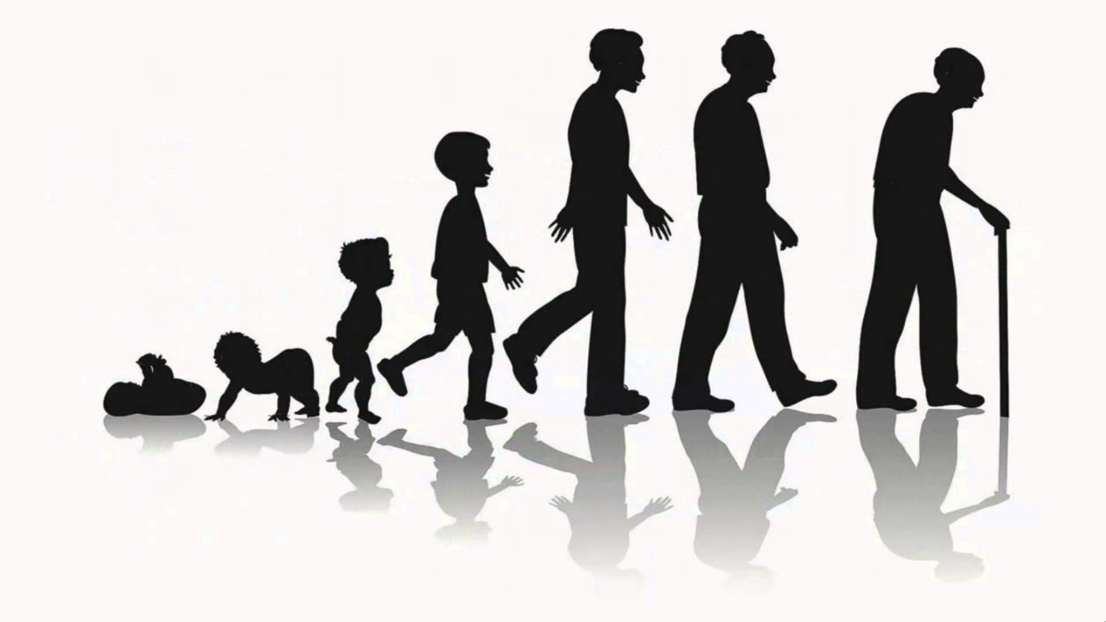
Life Expectancy Prediction
Kesav Adithya Venkidusamy
DSC680-T301 Applied Data Science, Bellevue University
Professor Catherine Williams
Notes:
Today I would like to present my findings in a predictive analytics project to determine life expectancy based on a set of variables.

Slide 2
Summary
Introduction
Data Mining & EDA
Predictive Modeling and Analysis
Findings and Recommendation
Ethical Consideration
Presentation Title

Slide 3
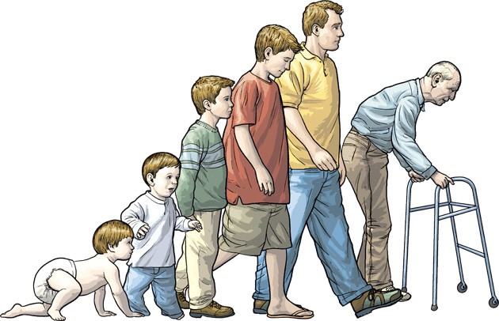
Introduction
Everything has an expiration date; humans are no exception either.
The term “life expectancy” refers to the number of years a person can expect to live.
By definition, life expectancy is based on an estimate of the average age that members of a particular population group will be when they die
In this project, I aim to explore the parameters affecting the life span of individuals living in distinct countries and learn how the life span can be estimated with the help of machine learning models

Slide 4
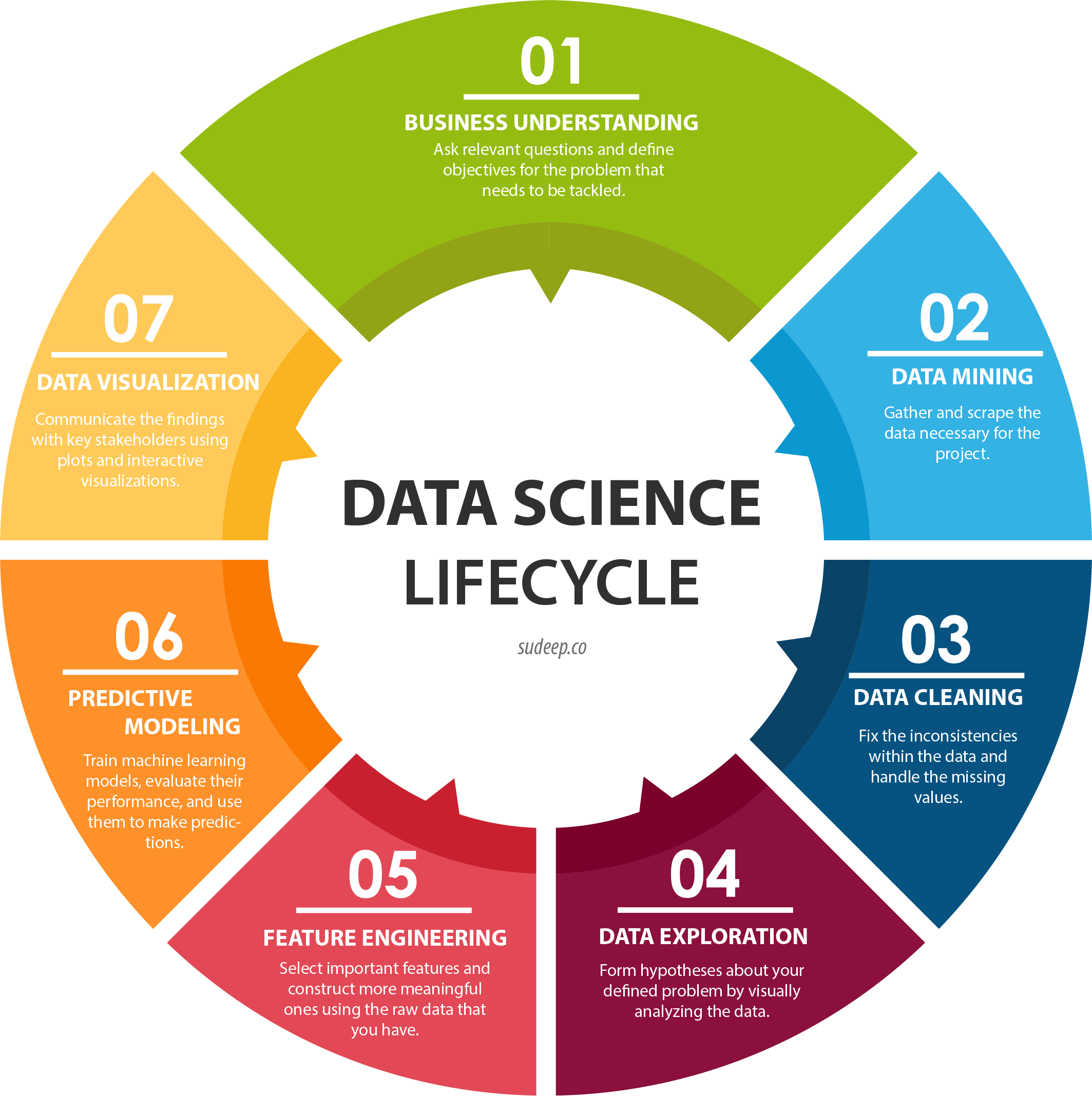
Life Expectancy Prediction Life Cycle
Notes:
The data science life cycle represented on this slide shows the process used to develop the data and create a model to determine predictions. I started with the problem definition where I formulate the question I am trying to answer. Once that has been defined, I move to data mining and data preparation. In this phase, I evaluate data, make sure it meets my needs, and start the cleaning process. This phase also includes creating visualizations to show another angle of the data and make any needed changes to prepare for modeling. Feature engineering involves scaling data so that it is represented equally for the modeling process. The data structure and the evaluation of visualizations will help to decide the best model to use. Depending on that outcome we may choose to reevaluate using a different model. This process continues until the outcomes are determined to use with future data.

Slide 5
Data Mining – Data Structure
Feature Name | Feature Description | Feature Type
Country | Country Observed | Discrete
Year | Year Observed | Continuous
Status | Status of the country; Developed or Developing Status | Discrete
Life expectancy | Life expectancy in age | Target
Adult Mortality | Adult Mortality Rates on both sexes (probability of dying between 15-60 years/1000 population). | Continuous
Infant deaths | Number of Infant Deaths per 1000 population | Continuous
Alcohol | Alcohol recorded per capita (15+) consumption (in liters of pure alcohol). | Continuous
Percentage expenditure | Expenditure on health as a percentage of Gross Domestic Product per capita(%). | Continuous
Hepatitis B | Hepatitis B (HepB) immunization coverage among 1-year-olds (%) | Continuous
Measles | Number of reported Measles cases per 1000 population | Continuous
Feature Name | Feature Description | Feature Type
BMI | Average Body Mass Index of the entire population | Continuous
Under-five-deaths | Number of under-five deaths per 1000 population | Continuous
Polio | Polio (Pol3) immunization coverage among 1-year-olds (%) | Continuous
Total expenditure | General government expenditure on health as a percentage of total government expenditure (%) | Continuous
Diphtheria | Diphtheria tetanus toxoid and pertussis (DTP3) immunization coverage among 1-year-olds (%) | Continuous
HIV/AIDS | Deaths per 1 000 live births of HIV/AIDS (0-4 years) | Continuous
GDP | Gross Domestic Product per capita (in USD) | Continuous
Population | The population of the country | Continuous
thinness 1-19 years | Prevalence of thinness among children and adolescents for Age 10 to 19 (%) | Continuous
thinness 5-9 years | Prevalence of thinness among children for Age 5 to 9(%) | Continuous
Income composition of resources | Human Development Index in terms of income composition of resources (index ranging from 0 to 1) | Continuous
Schooling | Number of years of Schooling(years) | Continuous
Notes:
The data for my project is extracted from Global Health Observatory (GHO) data repository maintained by WHO. The problem statement of this project is to identify the features which are mostly related to or affecting the life expectancy of the country. With the dataset having around 3000 records, I will be able to predict an answer to our problem statement. The dataset consists of 22 features of which 19 are numerical and 2 are categorical with “life expectancy” being the target. The target variable life expectancy is a continuous variable.

Slide 6

Data Cleansing
Missing/Null Check - Null values are present for the below features. The same is replaced with the forward-filling method
Hepatitis B
Alcohol
Adult Mortality
Polio
Total Expenditure
GDP
Population
Schooling
Income Composition of resources
Life Expectancy
Diphtheria
Thinness 5 to 9 years
Thinness 1 to 19 years
BMI
Duplicate Check - No duplicate value in the dataset
Unwanted features Removal - All the features present in the dataset are considered for modeling
Notes:
As part of the first step in data cleaning, a null check has been performed on the data and found few null values in the features listed in this slide. Those null values are replaced by a forward-filling method. Then a duplicate check is performed and found no duplicates. All the features are considered significant for modeling.

Slide 7
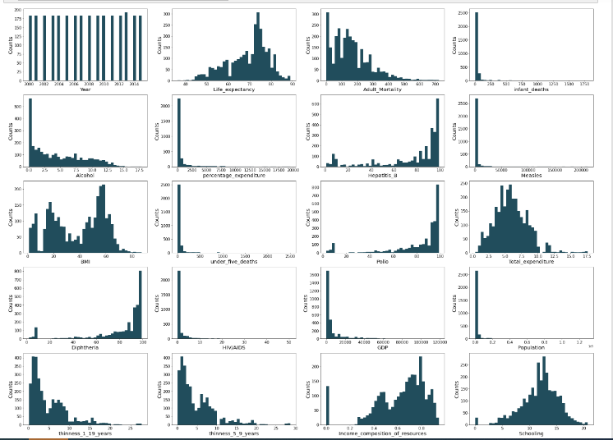
EDA - Numerical Variables
Year
Life_expectancy
Adult_Mortality
Infant_deaths
Alcohol
Percentage_expenditure
Hepatitis_B
Measles
BMI
Under_five_deaths
Polio
Total_expenditure
Diphtheria
HIV/AIDS
GDP
Population
thinness_1_19_years
thinness_5_9_years
Income_composition_of_resources
Schooling
Notes:
As part of EDA on numerical variables, the histogram chart has been drawn. I see the features <> are rightly skewed.
Adult Mortality
Infant_death
Alcohol
Percentage Expenditure
Measles
Under five deaths
HIV/AIDS
GDP
Population
thinness_1_19_years
thinness_5_9_years
Left Skewed
The features <> are left skewed.
Hepatitis B
Diphtheria
Income composition of resources
Polio
Normal Distribution
Life Expectancy - The value is high between the age of 70 to 75 all over the world
Total Expenditure - The value is high around 5
Schooling - The maximum occurred between the range of 10 to 15
Multimode Distribution
A multimodal distribution is a probability distribution with more than one peak, or “mode.” A bimodal distribution is also multimodal, as there are multiple peaks. The below feature has multimodal distribution
BMI

Slide 8
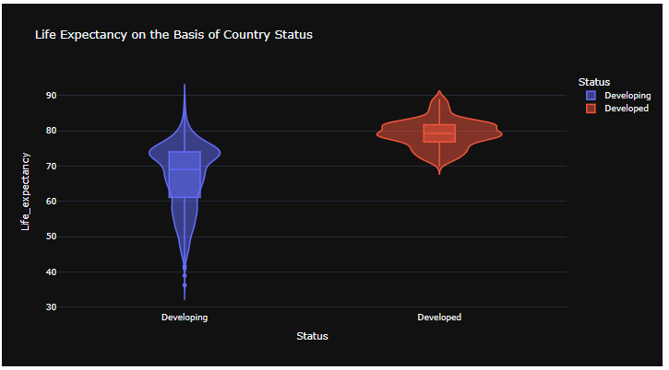
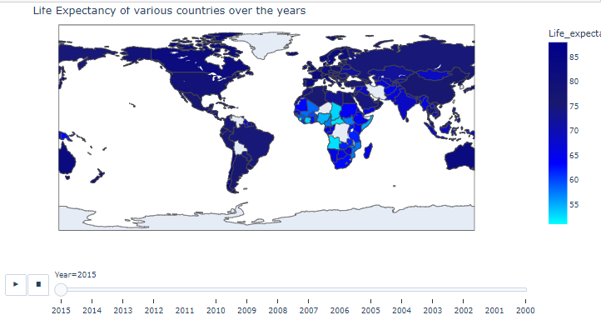
EDA - Categorical Variables
Country
Status
Notes:
This is the EDA for Categorical variables. Looking at the violin and map charts, we could see Developing countries have a low life expectancy compared to developed countries. In addition, we could notice that life expectancy has increased over the years across the countries.

Slide 9
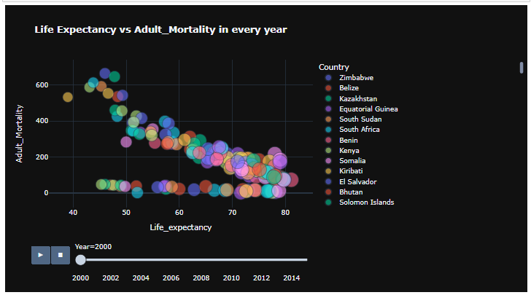
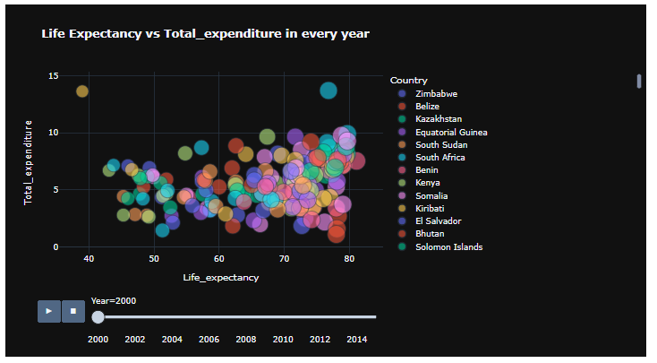
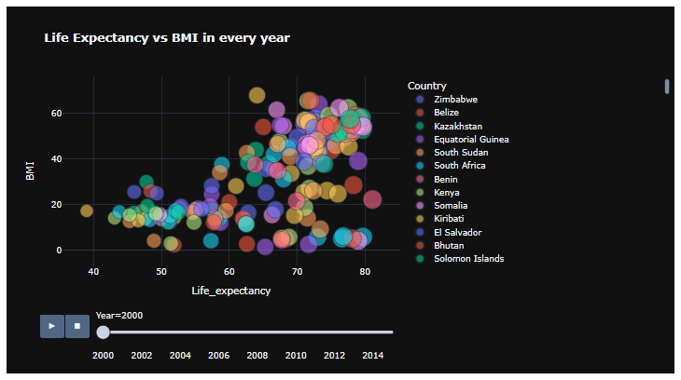
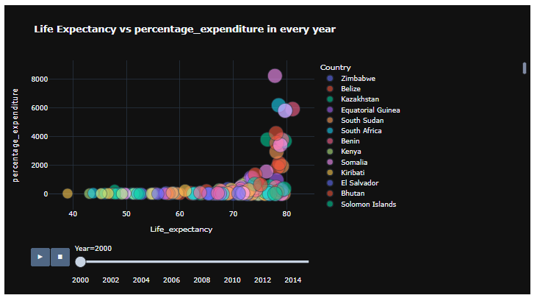
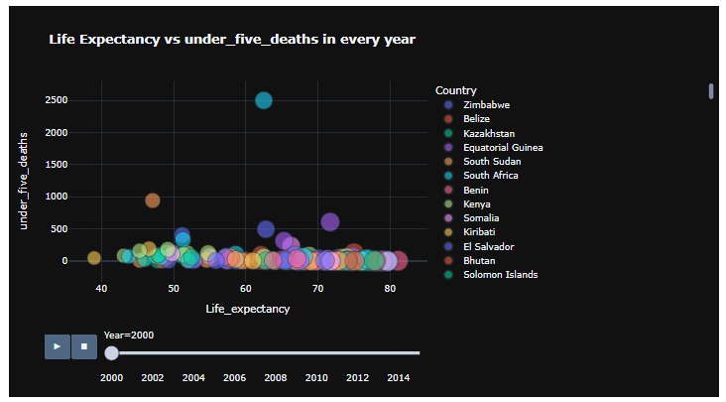
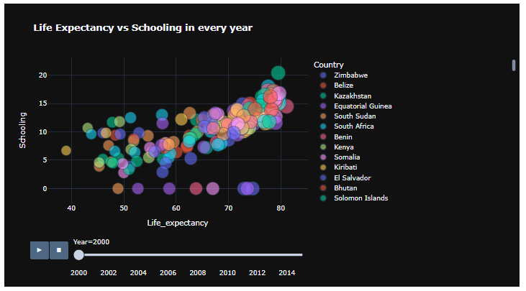
EDA - Target Variable “Life Expectancy” Analysis
Notes:
This is EDA for the target variable “Life expectancy”. From the charts, I see
The adult mortality rate is low for developed countries compared to developing countries.
In most countries the total expenditure lies below 10 and only limited countries are having expenditures greater than 10. Most of the values for life expectancy lie in the range of 40 and 90. The United States is having high total expenditure and life expectancy. Life expectancy has increased over years for all the countries
Most of the countries are having values less than 500. India is having high under 5 deaths. This might be due to population as India is the 2nd largest population country in the world. However, over the years, under-five deaths have reduced in India.
Over the years, the BMI across the countries has increased which results in high life expectancy. This is because people are more cautious about their health nowadays compared to the past.
Schooling also plays a major role in improving life expectancy. Schooling gradually increases over the years which results in high life expectancy.

Slide 10
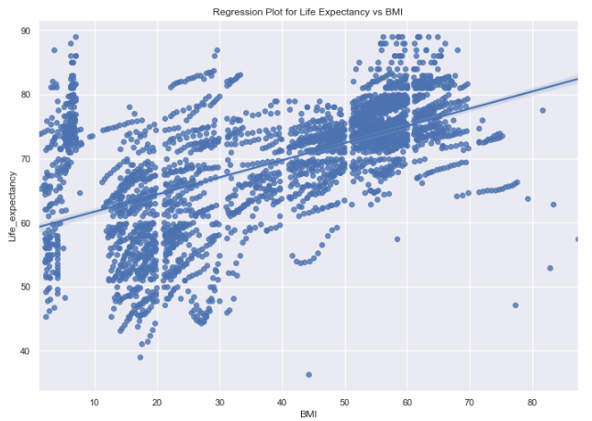
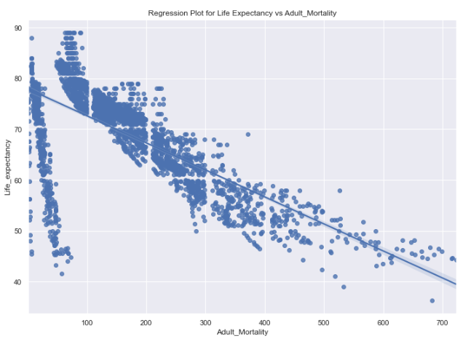
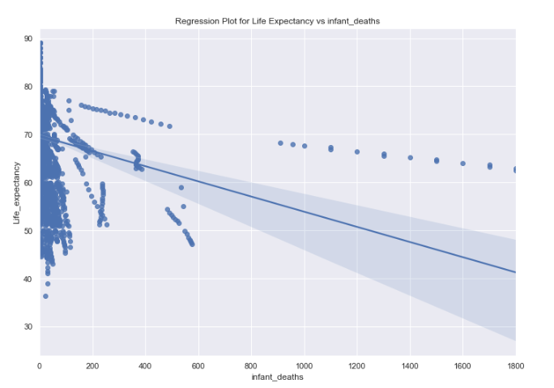
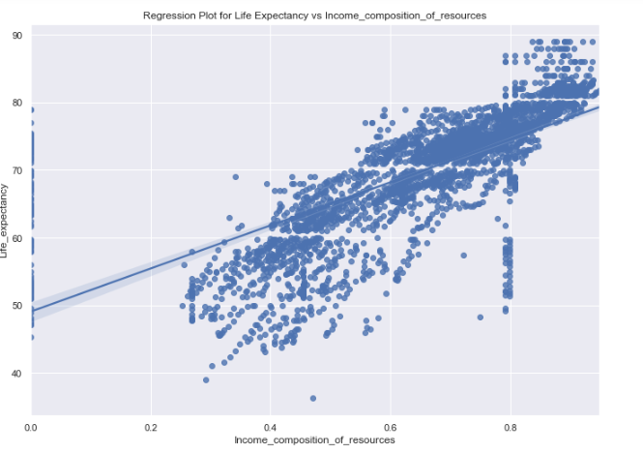
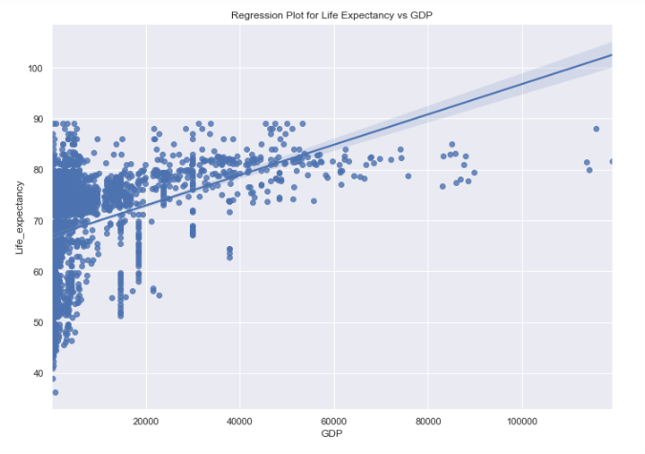
EDA - Target Variable “Life Expectancy” Analysis
Notes:
From the regression plot, I could see life expectancy increase for the increase in BMI, GDP, and income composition of resources and decrease for the increase in adult mortality and infant deaths.

Slide 11

Feature Engineering
The below methods were applied on the features prepping them for model building
Label Encoder
Country
Status
MinMaxScaler
Standard Scaler
Notes:
Label Encoding is applied to categorical variables to convert them to numerical values. In addition, MinMaxScaler is applied to normalize the data, and StandardScaler is applied to standardize the data.

Slide 12
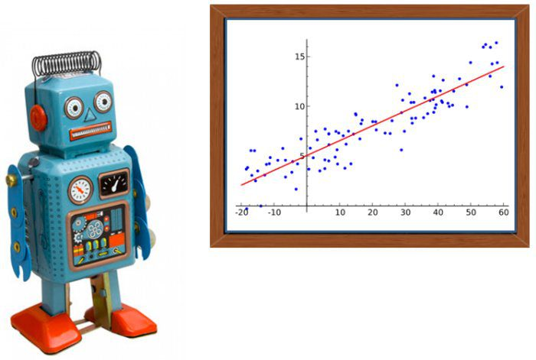
Linear Regression & Measures
Linear regression is a linear model which is a model that assumes a linear relationship between the input variables (x) and the single output variable (y)
Uses
Forecasting
Time series Analysis
Effect Relation between variables
Finding the cause
Performance
R2 (R-Squared)
Root Mean Square Error
Notes:
Since the target is a continuous variable, linear regression modeling is applied. Linear regression is a linear model which is model that assumes a linear relationship between the input variables (x) and the single output variable (y). Mainly used in forecasting, time series analysis, and finding the cause. Performance of this modeling is measured in R2 and root mean square error.

Slide 13

Performance of the model
Methods | R2 Score | RMS Error
Without Normalization | 83.54% | 14.26
With MinMaxScaler Normalization | 83.54% | 0.00513
R-squared value < 0.3 this value is generally considered a None or Very weak effect size
R-squared value 0.3 < r < 0.5 this value is generally considered a weak or low effect size
R-squared value 0.5 < r < 0.7 this value is generally considered a Moderate effect size
R-squared value r > 0.7 this value is generally considered a strong effect size
Notes:
Linear regression is applied to the input data with and without applying the normalization technique. Among the 2 linear regression models, the one with the MinMaxScaler normalization technique applied gives a better result with a low root mean square error value.

Slide 14
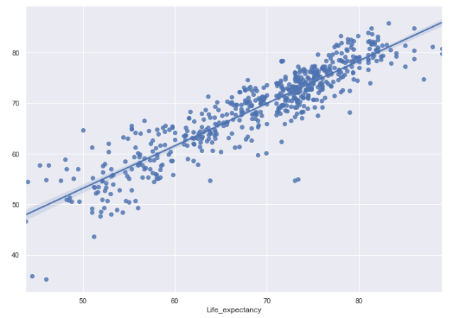
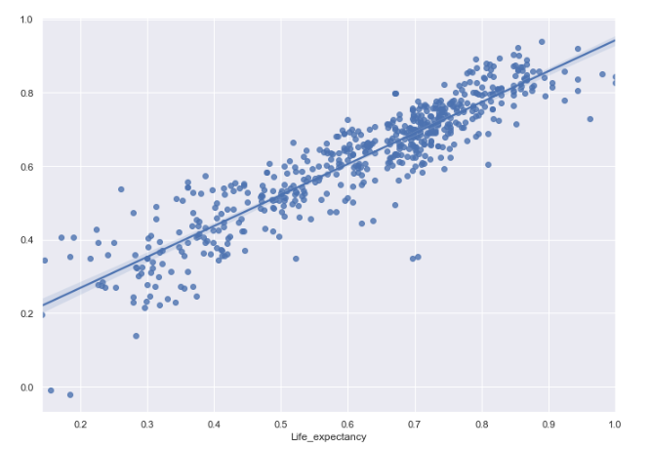
Regression Plot for Predicted Values
Without Normalization
With Normalization
Notes:
Regression plot for the predicted values with and without the normalization technique.

Slide 15
Analysis - Best Performing Features
Test | Features
Pearson's correlation matrix Feature correlation to target variable "life expectancy" | Positive Correlation: Schooling Income composition of resources BMI Negative Correlation: Adult Mortality HIV/AIDS Thinness_1_9_years
Lasso Regression | BMI Polio Diphtheria Income composition of resources Schooling
Ordinary Least Square (OLS) | Year Hepatitis_B GDP Population thinness_1_19_years thinness_5_9_years
Notes:
Observations were made to determine the best-performing features. I used Pearson's correlation matrix, Lasso Regression, and Ordinary Least square to make these determinations.

Slide 16
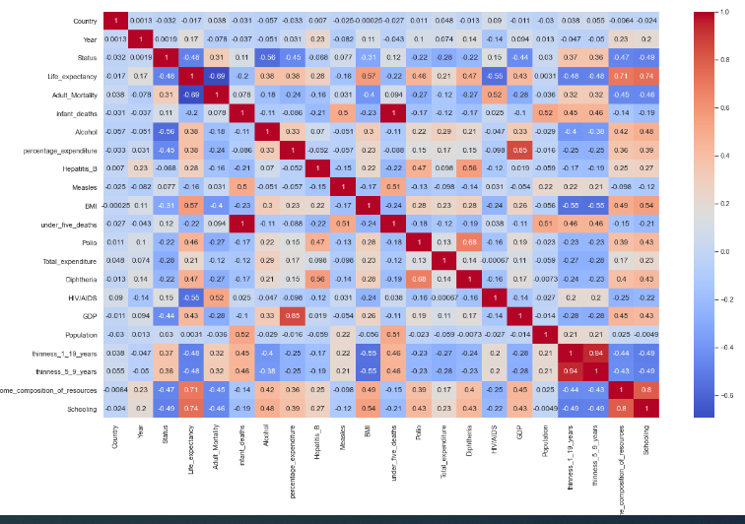
Pearson’s Correlation Matrix
Positive Correlation:
Schooling
Income composition of resources
BMI
Negative Correlation:
Adult Mortality
HIV/AIDS
Thinness_1_9_years
Notes:
Pearson's correlation matrix represents a comparison of the variables to our target variable life expectancy. Schooling, Income composition of resources, and BMI are positively correlated with the target while Adult Mortality, HIV/AIDS, and Thinness_1_9_years are negatively correlated.

Slide 17
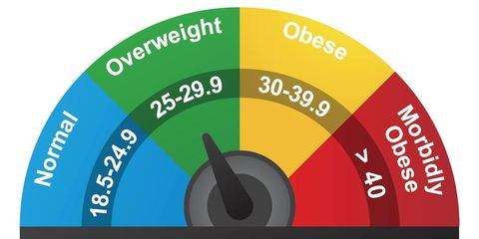
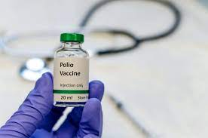
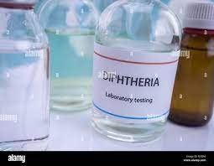


Lasso Regression – Best Features
BMI
Polio
Diphtheria
Income Composition of resources
Schooling
Average Body Mass Index of the entire population
Polio (Pol3) immunization coverage among 1-year-olds (%)
Diphtheria tetanus toxoid and pertussis (DTP3) immunization coverage among 1-year-olds (%)
Number of years of Schooling(years
Human Development Index in terms of income composition of resources (index ranging from 0 to 1)
Notes:
Lasso regression is another method to test the dependency of a variable on the target. With this method, I was able to determine that BMI, Polio, Diphtheria, Income composition of resources and schooling are the best features.

Slide 18
OLS - Best Features
Hepatitis - B
thinness_1_19_years
Hepatitis B (HepB) immunization coverage among 1-year-olds (%)
Prevalence of thinness among children and adolescents for Age 10 to 19 (%)
Year
Year Observed
GDP
Population
Gross Domestic Product per capita (in USD)
The population of the country
Notes:
Finally, the Ordinary Least Square method is used to determine the best features correlated to the target. Year, Hepatitis-B, GDP, Population, and thinness_1_19_years turned out to be the best features using this method.

Slide 19


Findings and Recommendation
Model
Linear Regression model applied on normalized data provides the best result for Life Expectancy prediction.
The score (R2) turned out to be 83.54% with a Root Mean Square Error of 0.00513
Features having a high impact on the target variable Life Expectancy
Schooling
Income composition of resources
BMI
Polio
Diphtheria
GDP
Adult Mortality
HIV/AIDS
Notes:
Linear Regression model applied on normalized data provides the best result for Life Expectancy prediction with R2 score of 83.54% and a Root Mean Square Error of 0.00513.

Slide 20

Suggestions
Schooling is having a high impact on our target “life expectancy”. So, providing proper education to children would increase the life expectancy of the people
Providing proper vaccinations like Polio, Diphtheria, and Hepatitis-B to children at the correct age also improves the life expectancy of the people in the country.
Income composition of resource is also having an impact on life expectancy. People who earn more have a longer life compared to those who earn less. So, the government should focus on improving the household income for the people.
Individuals should focus on improving their BMI which would subsequently improve their lifetime.
GDP is also having a positive correlation with life expectancy. So, the government should focus on improving the GDP of their country which would increase the life expectancy of the people.
Notes:
These are my suggestions to increase the life expectancy.

Slide 21
Ethical Considerations
One of the ethical considerations for this project is the consideration of results from the analysis in decision-making. Some of the conclusions made from this project’s study could be incorrect or misrepresented due to insufficient or incorrect data. So, while sharing the outcome of this project with a larger audience, the underlying assumptions and data considerations should be shared.
No personal and sensitive information is present in the dataset. This dataset is an extract from Global Health Observatory (GHO) data repository governed by WHO and made available for public use. So, this dataset doesn’t have any sensitive information.
Notes:
These are some of the ethical considerations considered during the project.

Slide 22
Reference
KUMARRAJARSHI (2017). Life Expectancy (WHO). https://www.kaggle.com/datasets/kumarajarshi/life-expectancy-who
Arya Andhika (2019-08-12): Life Expectancy Prediction using Regression. https://rstudio-pubs-static.s3.amazonaws.com/534874_2bdd7c6645804fd1b240e1ca3a9eb9d6.html
World Health Organization: https://www.who.int/data/gho, https://www.who.int/data/gho/data/themes/mortality-and-global-health-estimates
Shashank Gupta. https://www.enjoyalgorithms.com/blog/life-expectancy-prediction-using-linear-regression
Caitlin McDonnell (2018-02-04). Machine learning to predict life expectancy. https://towardsdatascience.com/what-really-drives-higher-life-expectancy-e1c1ec22f6e1

Slide 23




Thank you

